Slide 1
MolSim WS 23/24
Sheet 3
XML, Linked-Cell-Algorithm and
“Falling Drop - Wall”
Group C [Manuel, Tobias, Daniel]
05.12.2023

Slide 2
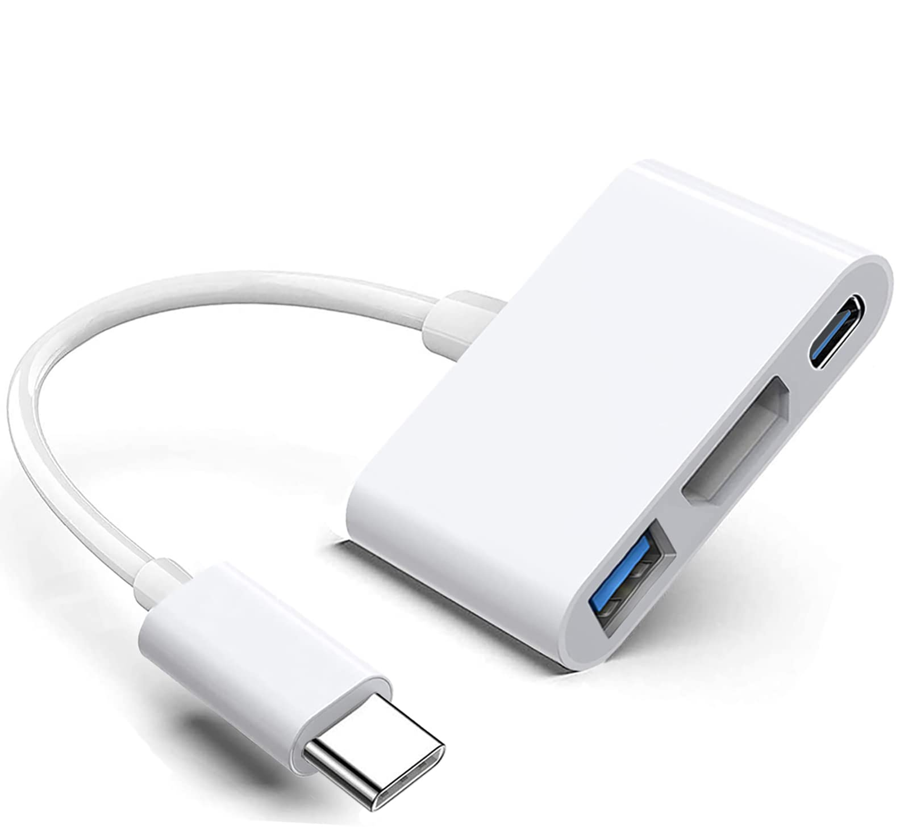
XML- Input
Create a xml-schema
⇒ We oriented ourselves on our own classes
⇒ e.g. element for a particle container
⇒ Less complex code
Use of adapter pattern
⇒ e.g. XSD-Cuboid to Cuboid-Spawner

Slide 3
Linked-Cells-Algorithm
Implementation & Optimizations:
Essentially a list of cells
Additional data structure for optimization
⇒ lists for: occupied-, halo-, neighbor-...cells
Utilize Newtons 3rd law on particle and cell level
3
6
9
2
5
8
1
4
7

Slide 4
Linked-Cells-Algorithm
Implementation & Optimizations:
Essentially a list of cells
Additional data structure for optimization
⇒ lists for: occupied-, halo-, neighbor-...cells
Utilize Newtons 3rd law on particle and cell level
3
6
9
2
5
8
1
4
7

Slide 5
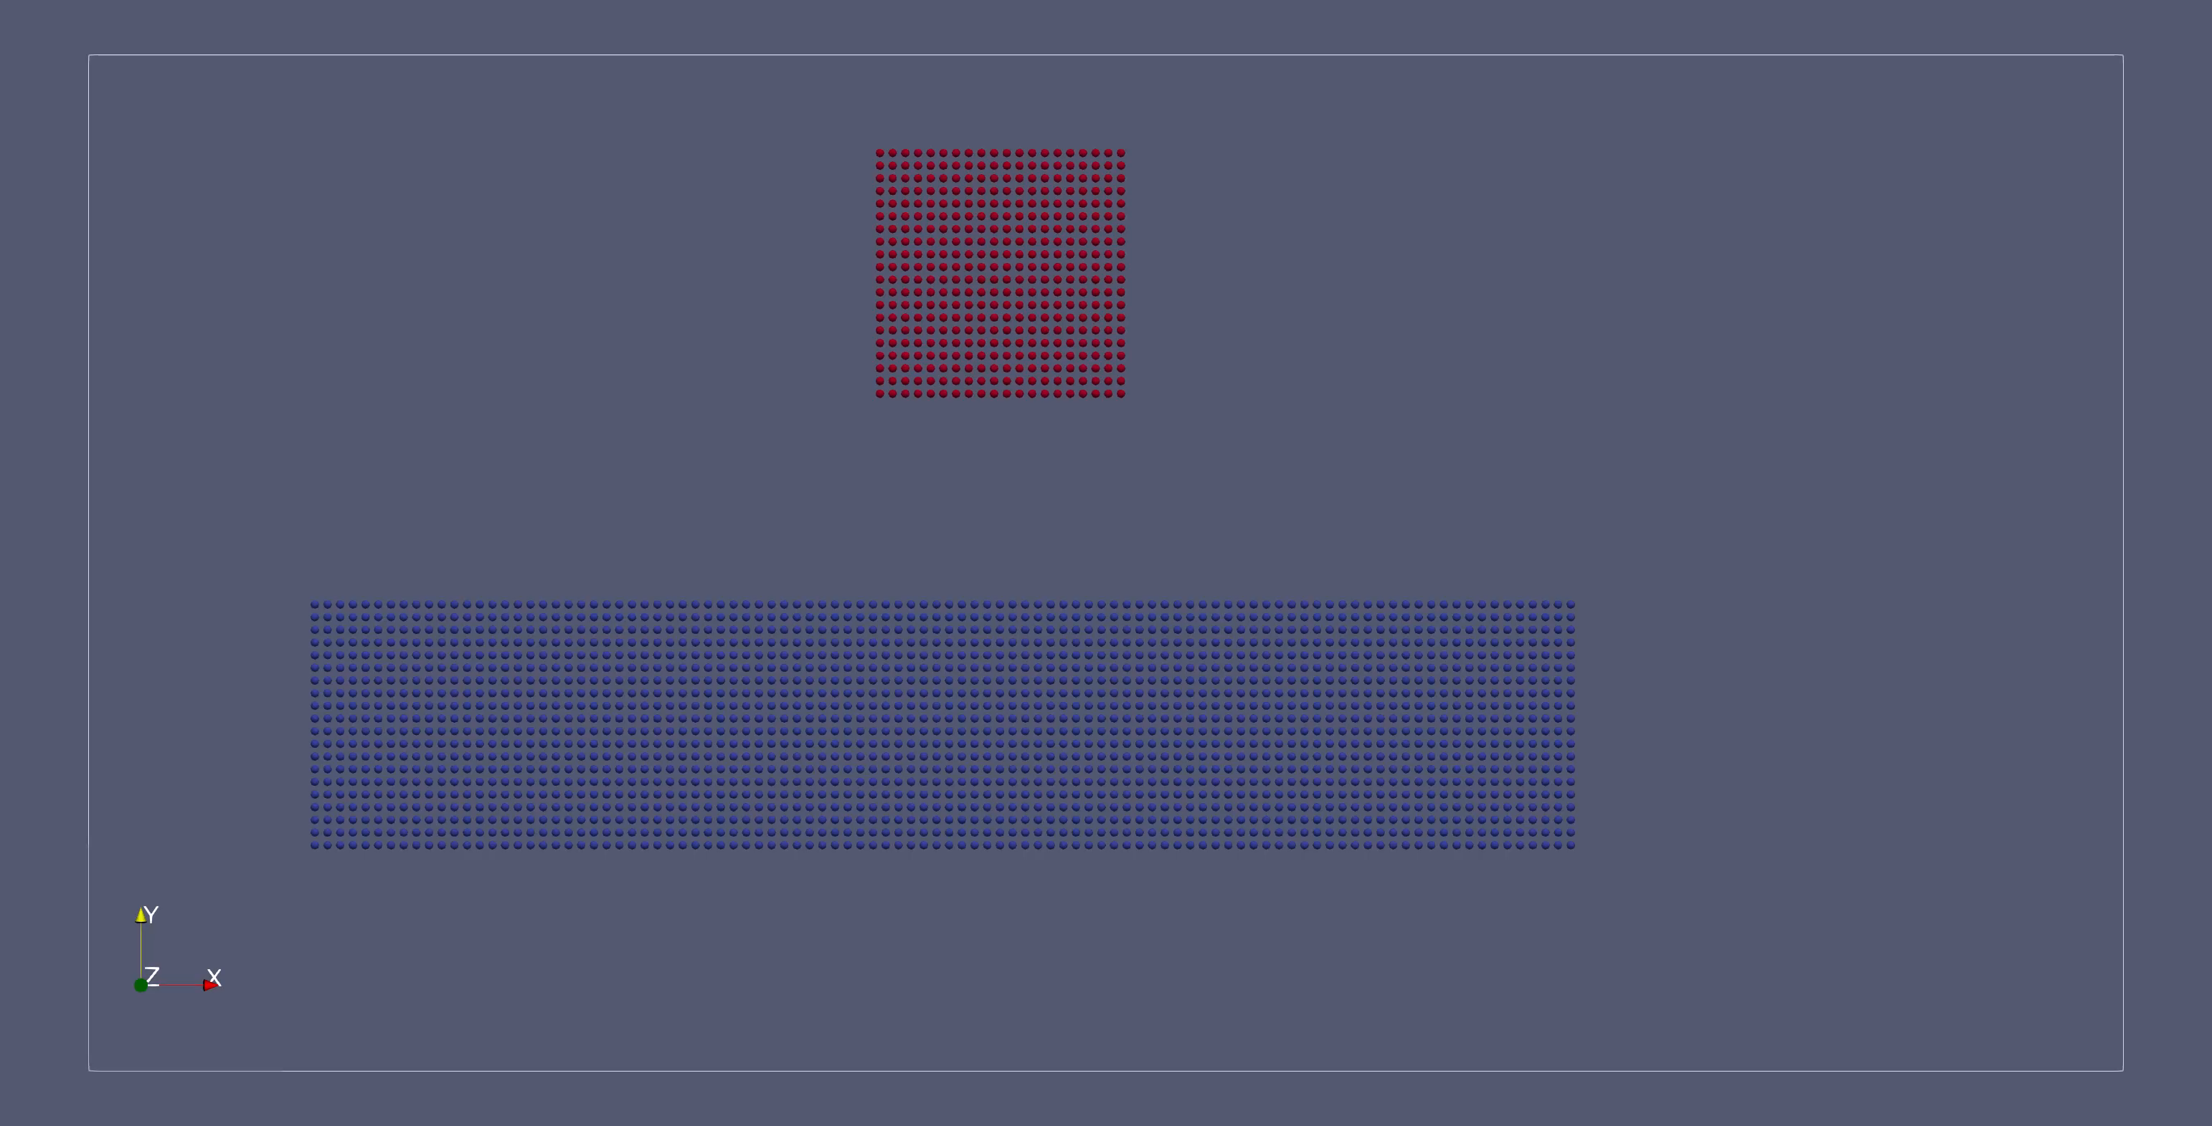
Linked-Cells-Algorithm
https://manuellerchner.github.io/MolSim-WS23-24/submissions/

Slide 6
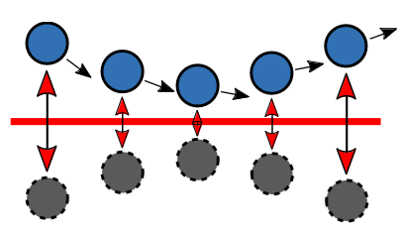
Linked-Cells-Algorithm
Outflow Boundaries:
Simple implementation
⇒ Delete particles in halo cells
Reflective Boundaries:
Creation of hypothetical particle
Ghost particle is not saved
⇒ more memory efficient
⇒ less complex in our code base
Only exists during force calculation

Slide 7
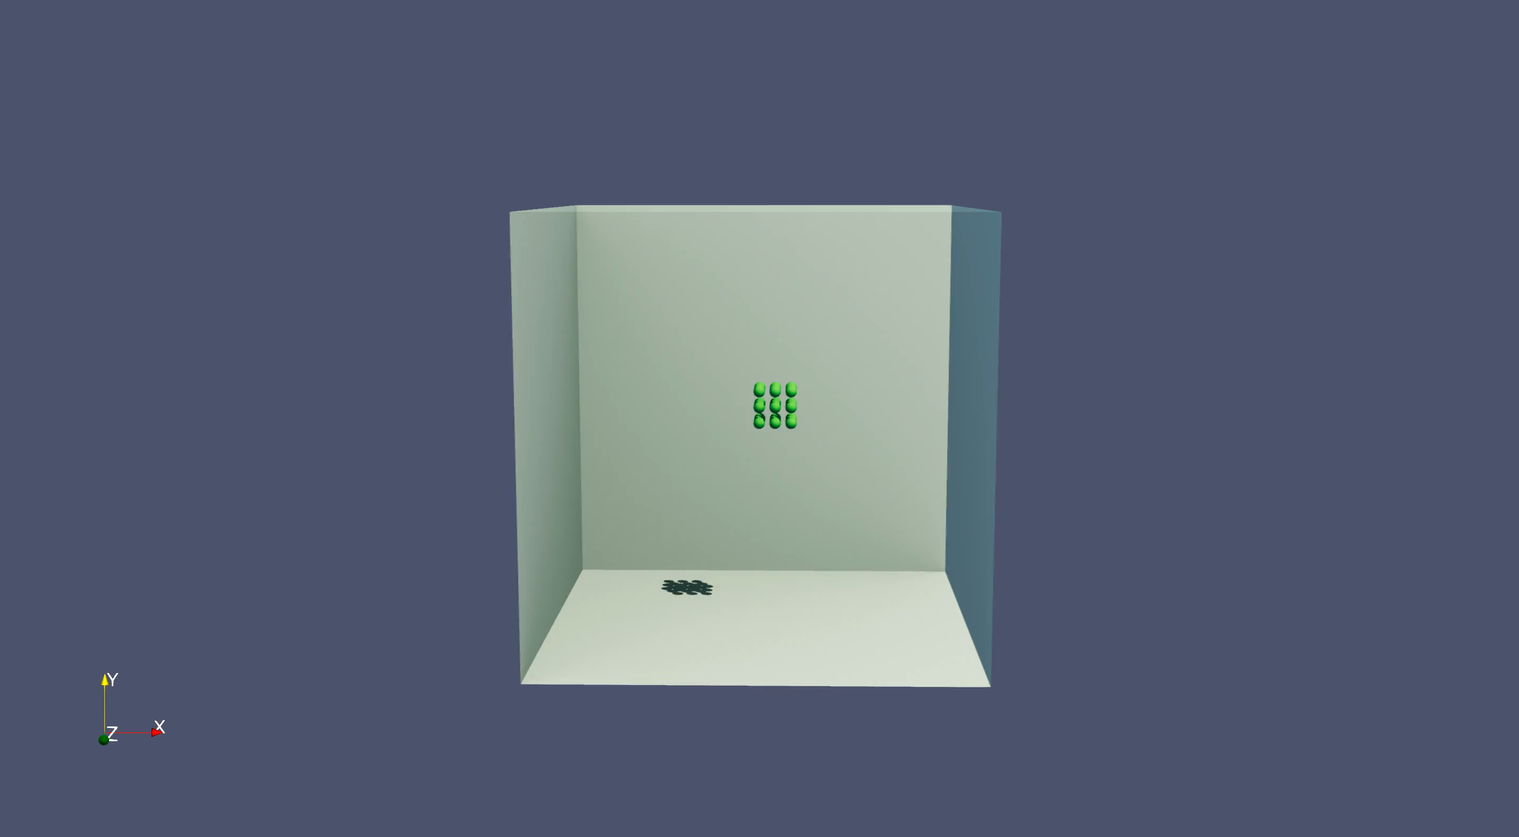
Linked-Cells-Algorithm

Slide 8
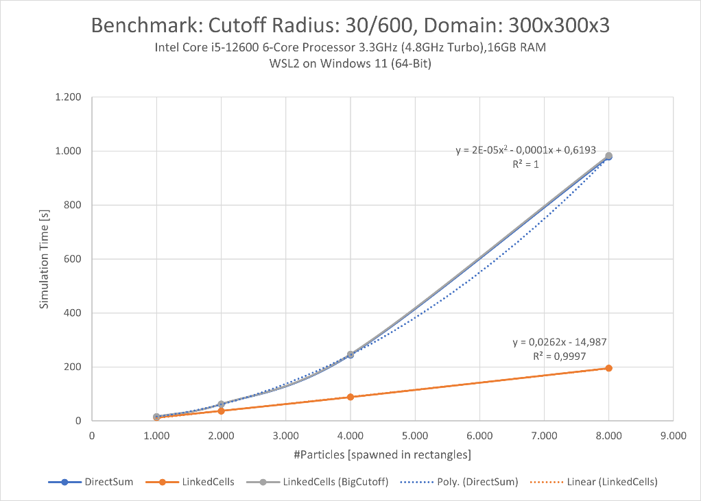
Linked-Cells-Algorithm
Performance:
We tested on WSL and native Ubuntu
Direct sum container: Quadratic Growth
Linked Cells container: Linear Growth
⇒ Very good approximation

Slide 9
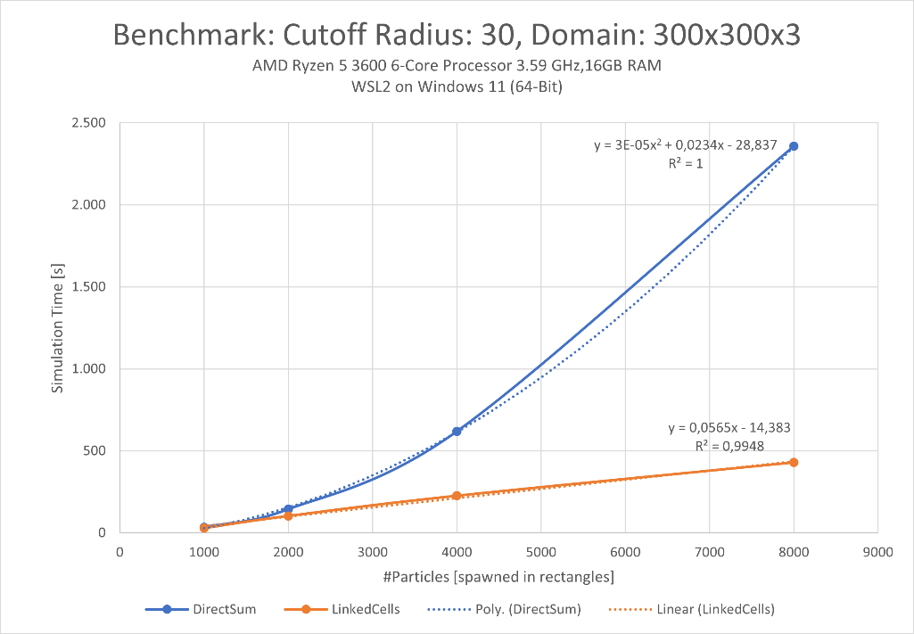
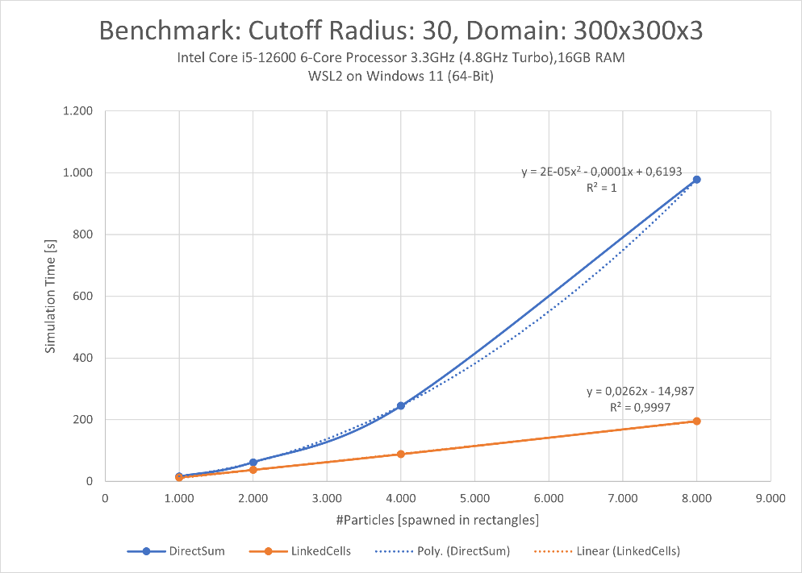
Linked-Cells-Algorithm

Slide 10
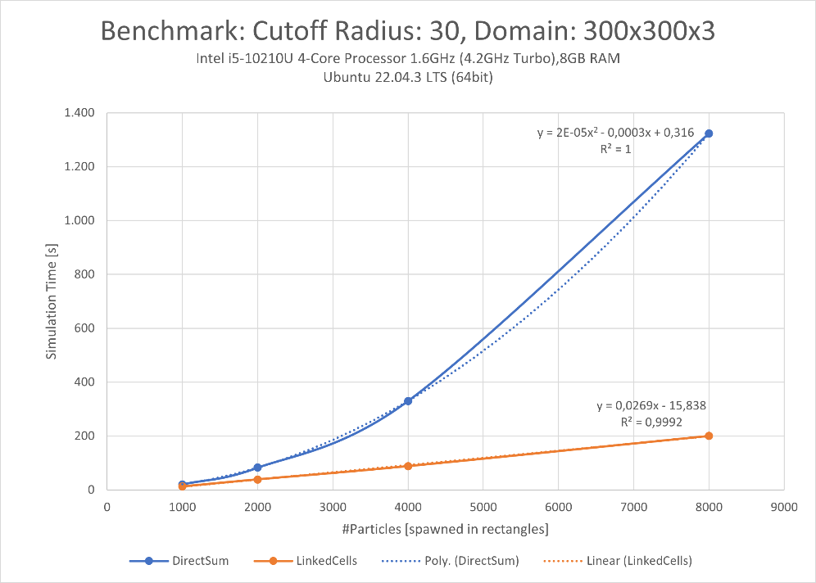
Linked-Cells-Algorithm

Slide 11
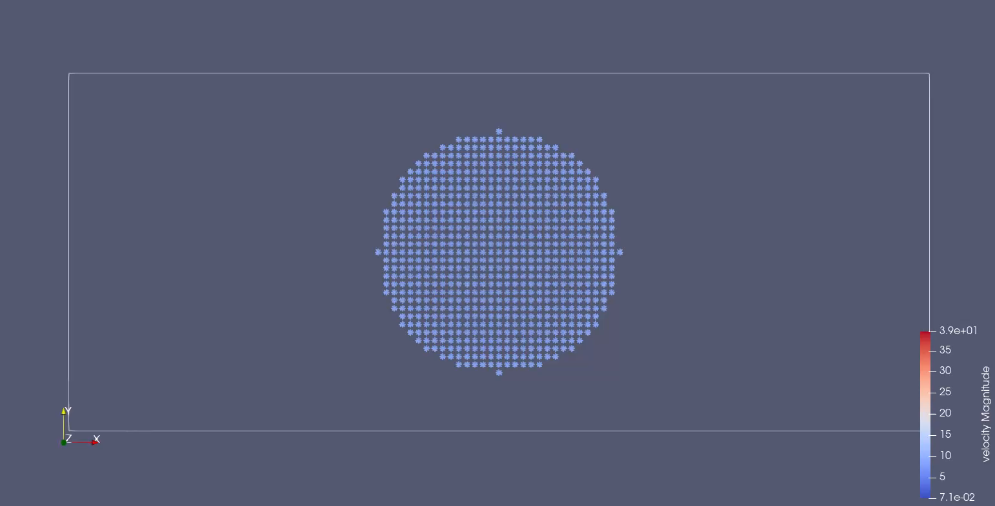
Simulation of a falling drop - Wall

Slide 12
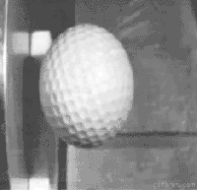
Simulation of a falling drop - Wall
Expectations:
Forces only between particles
⇒ should look like a water drop in space
Observation:
Snowball contracts and then scatters
Macro scale (looking at ball as one object):
Kinetic energy ⇒ Deformation energy ⇒ Kinetic energy
Deformation becomes an emergent phenomenon

Slide 13
Summary of cool things
We enabled XML-Input
We accelerated our simulation with a new container
We drew a pretty performance plot
We implemented boundaries and particles bouncing in an “aquarium”
We made a pretty video of a snowball thrown at a wall

Slide 14
References
Adapter picture: https://www.amazon.de/Digital-Multiport-Schnellladeanschluss-2016-2022-2018-2022-Wei%C3%9F/dp/B0BPJQYVQ3
Golf ball collision: https://gifer.com/en/gifs/collisions
Our submission material hosted on Github Pages: https://manuellerchner.github.io/MolSim-WS23-24/submissions/

